Slide 1
How does culture influence the communities we serve?

Slide 2
Objectives
Participants will be able to:
Discuss how culture, popular culture and media (social media, news, films, music, etc.) influence the way society thinks about sexual assault and violence against women.
Identify several ways in which gender bias may affect policing practices in sexual assault response.
Develop strategies to mitigate the influences of cultural myths, misperceptions, and gender bias on agency members.

Slide 3
Culture
What is culture?
Can individuals be a part of more than one culture?

Slide 4
Definitions of Culture
A body of beliefs, ideas, and ideals used for cohesion and conformity
The set of shared attitudes, values, goals, and practices that characterizes an institution or organization
The way of life, especially the general customs and beliefs, of a particular group of people at a particular time
The personality of a group
Notes:
Ujima, Inc.: The National Center on Violence Against Women in the Black Community
Merriam Webster Dictionary
Cambridge English Dictionary
https://www.thecultureblend.com/the-best-definition-of-culture-ive-ever-heard/

Slide 5
Culture Impacts Everyone
Victims
Offenders
Family and friends of victims and offenders
Criminal justice system members
Law enforcement
Prosecutors
Judges
Jurors

Slide 6
Culture Impacts Everyone
“Men shouldn’t….” and “women shouldn’t….” (behave, dress, talk, act a certain way)
“Real men” want sex all the time.
When women say no, they’re “playing hard to get”.
“Real” victims cry when they’re sexually assaulted.
“She was drinking with him and wearing a short skirt, what did she expect would happen?”

Slide 7
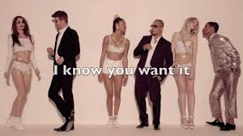

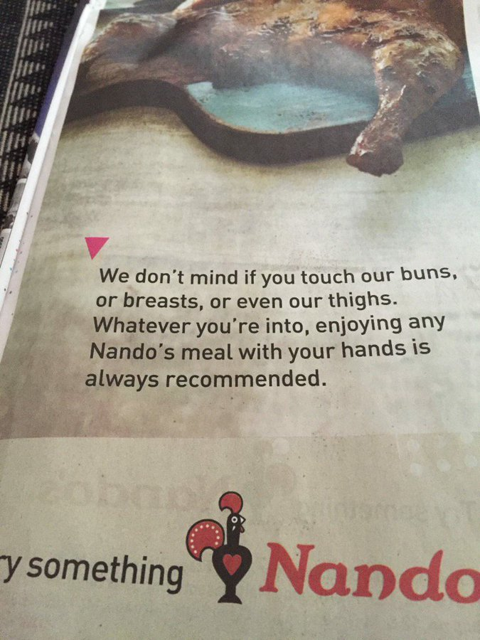
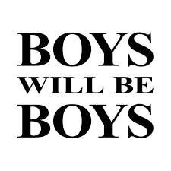




Slide 8

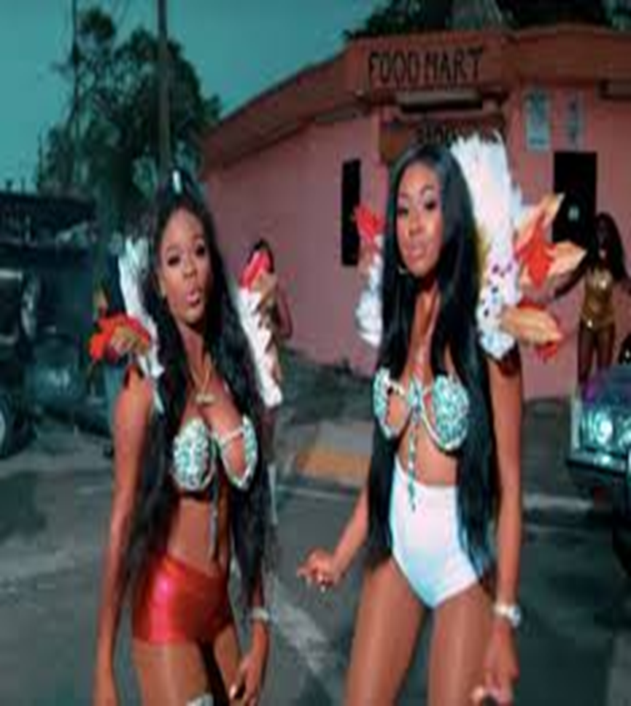
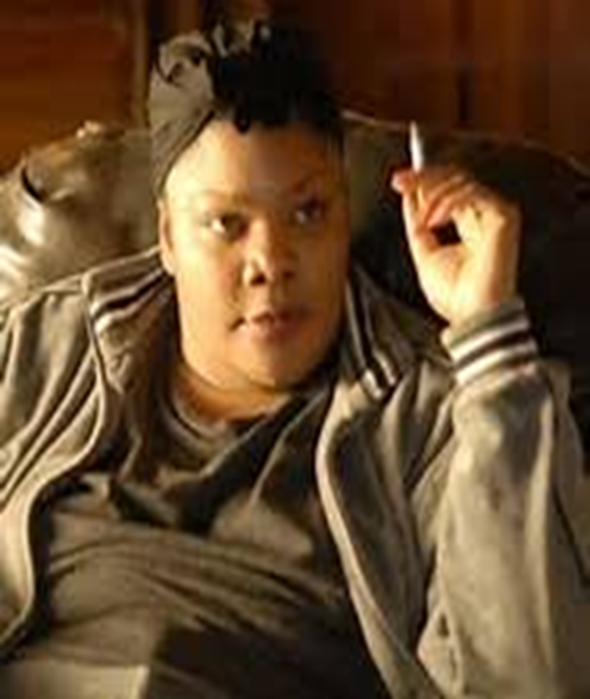

Slide 9

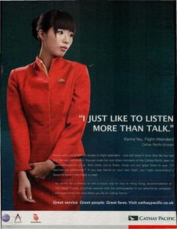
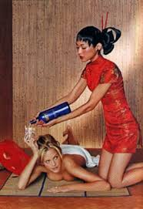

Slide 10
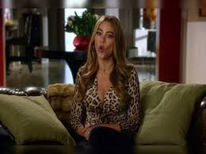
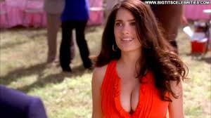

Slide 11
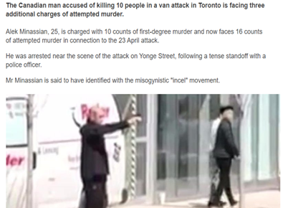
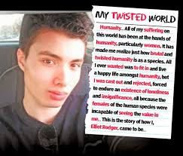
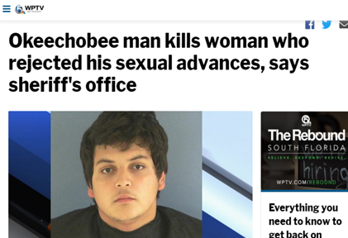
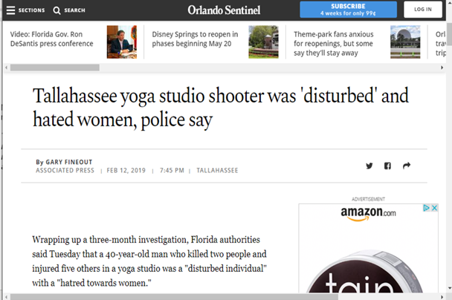

Slide 12
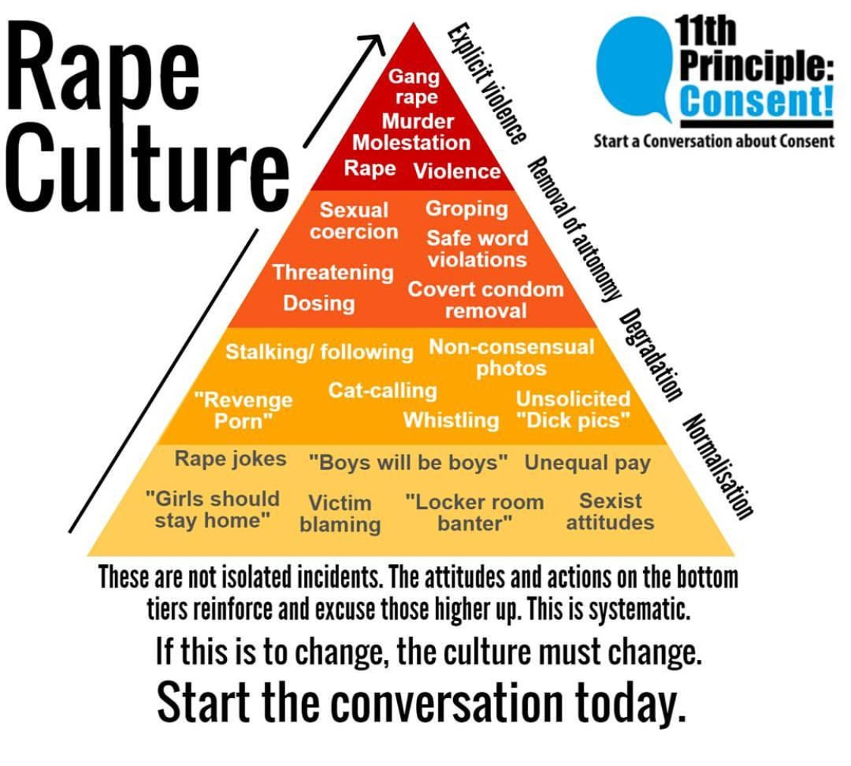

Slide 13
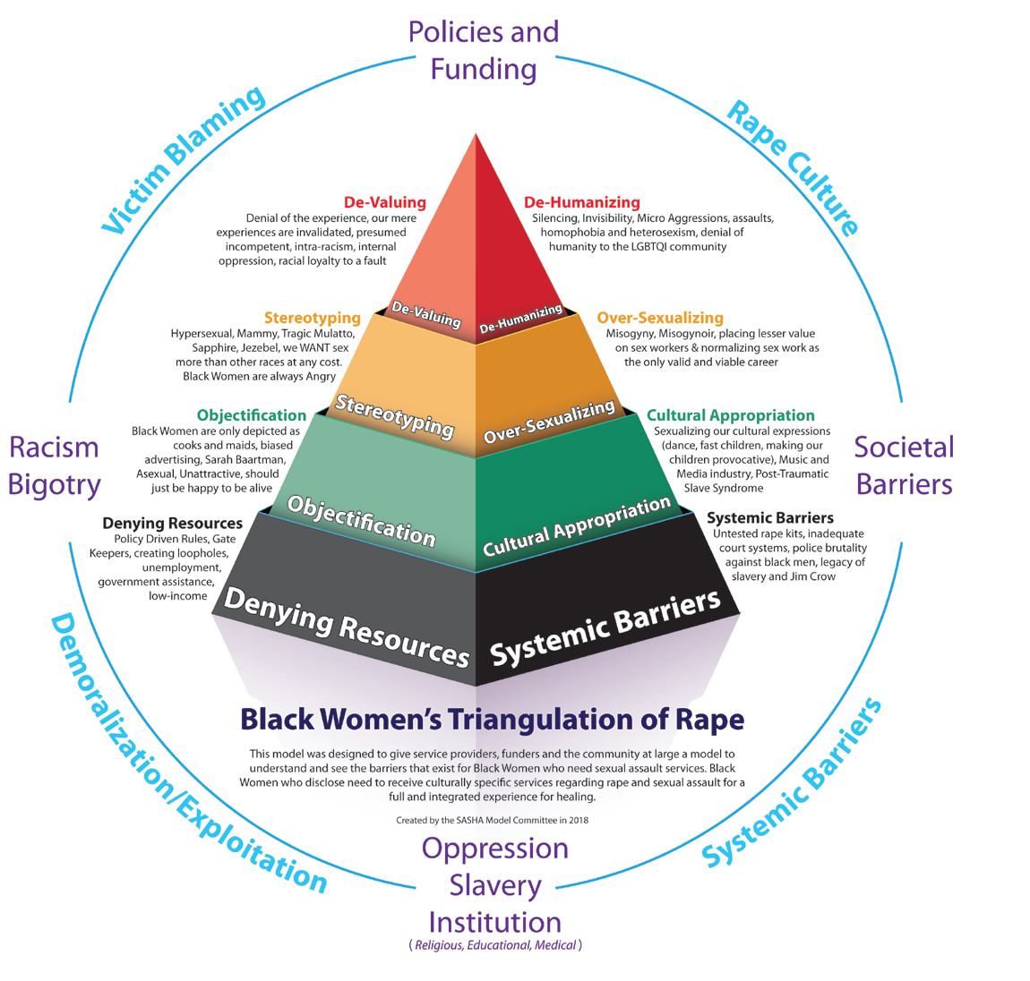
Violence Against Women in Culture

Slide 14
What is the result?
Take a few minutes to write down your thoughts:
How do these messages of violence against women in our culture influence:
victims?
offenders?
agency members?

Slide 15
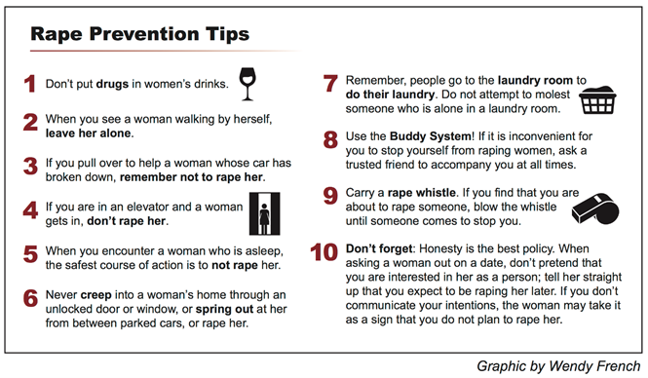

Slide 16
What is the result?
How do messages of violence against women in our culture influence victims?
Believe violence is to be expected
Have a passive response to the violence
Might not see the behavior as criminal
Blame themselves and experience stigmatization
Fear they will not be believed
May not report or be reluctant to participate in the criminal justice process
Distort ideas of femininity / masculinity

Slide 17
What is the result?
How do messages of violence against women in our culture influence offenders?
Feel a sense of entitlement
Believe violence is an option
Believe the victim is to blame
Reject responsibility
Believe that there will not be consequences
Distort ideas of femininity / masculinity

Slide 18
What is the result?
How do messages of violence against women in our culture influence agency members?
Continue to believe myths and misperceptions
Minimize the violence experienced
Desensitize officers
Suggest that victims’ behavior contributed to the violence
Distort ideas of femininity / masculinity

Slide 19
Police Response to Violence Against Women
U.S. Department of Justice (2015): Identifying and Preventing Gender Bias in Law Enforcement Response to Sexual Assault and Domestic Violence
Notes:
https://www.justice.gov/opa/file/799366/download

Slide 20
Impact of Culture
Beliefs and biases are part of culture
A belief is something we accept as true
A bias is a preference or association
We all have biases
Victims, perpetrators, friends, family members
Agency members
Biases can be
Positive or negative
Unconscious (implicit) or conscious (explicit)

Slide 21
Explicit and Implicit Bias
Explicit biases are conscious preferences and associations.
Implicit biases are attitudes or associations held without conscious knowledge.
98% of brain function is subconscious, like breathing and blinking.
Implicit biases are part of this subconscious and automatic brain function.

Slide 22
Explicit and Implicit Bias
Implicit bias Explicit forms of bias
“Implicit bias should free us from guilty feelings. We are not, individually, to blame. Understanding implicit bias is about knowing how our unconscious attitudes create different social and economic realities for historically stigmatized groups.”
http://www.centerforsocialinclusion.org/csis-guide-on-Implicit-bias/

Slide 23
Gender Bias
Gender bias is a preference or prejudice toward one gender over others.
Gender, separating people into women and men, is a way that cultures often classify people into groups, with expectations of how each group should behave, dress, talk, act, and more – for example, in the U.S. we separate people into women and men.
Gender bias can be conscious or unconscious.
Gender bias is derived from culture, traditions, norms, values, and/or experiences.

Slide 24
Gender Bias in Policing
Gender bias in policing practices can result in
Less protection for certain victims on the basis of gender
Failures to respond to crimes that disproportionately harm people of particular genders
Less robust services due to a reliance on gender stereotypes
USDOJ, Identifying and Preventing Gender Bias in Law Enforcement Response to Sexual Assault and Domestic Violence, 2016
Notes:
https://www.justice.gov/opa/file/799366/download

Slide 25
Gender Bias in Policing
Underreporting sexual assault or domestic violence
Misclassifying sexual assault or domestic violence
Treating domestic violence as a private family matter rather than a crime
Inappropriately concluding that sexual assault cases are unfounded or false
Failing to test sexual assault kits
Failing to enforce protection orders
Failing to treat same-sex domestic violence as a crime
Notes:
USDOJ, Identifying and Preventing Gender Bias in Law Enforcement Response to Sexual Assault and Domestic Violence, 2016

Slide 26
Gender Bias in Policing
Interrogating rather than interviewing victims and witnesses
Writing or approving lower quality reports
Using language in reports that is not victim centered or trauma informed (e.g. alleged victim, victim's story)
Lower rates of arrests for domestic violence or sexual assault
Higher rates of dual arrests for domestic violence
Not having dedicated staff/units for domestic violence despite high proportion of calls
Notes:
USDOJ, Identifying and Preventing Gender Bias in Law Enforcement Response to Sexual Assault and Domestic Violence, 2016

Slide 27
Activity
Take 3 minutes to write down how you think law enforcement agencies and officers can combat gender bias in policing.

Slide 28
Dismantling Gender Bias in Policing
Review and revise policies and procedures
Provide training
Gather pertinent evidence in an unbiased manner
Be aware of how victim behavior, memory, and actions are impacted by trauma, and use strategies to mitigate these impacts on investigations
Follow the evidence to conduct thorough investigations of all complaints received
Notes:
Law enforcement agencies should review and revise their policies and procedures as necessary; and
Provide training to officers to ensure that responding officers and investigators gather all pertinent evidence in an unbiased manner.
A victim’s nonconformance with behavioral stereotypes should not impact the way law enforcement officers evaluate the complaint.
Biases should also not prevent officers from taking a report or detectives from conducting a full investigation of all complaints received.

Slide 29
Dismantling Gender Bias in Policing
Examine influence of myths or stereotypes
Utilize data, facts, and circumstances to explore the truth about myths / stereotypes
Examine common reactions and whether these would change depending on how the person looked, sounded, or acted

Slide 30
